Slide 1
Verwendete Software

Slide 2

Operating System
Empfohlenenes Betriebssystem war das Raspbian Jessie, jedoch nach dem öfteren Versuchen mit verschiedenen Ansätzen konnte hier keine Funktionalität aller Programme erzielt werden.
→ Testen verschiedener anderer Versionen und OS führte schließlich zu einer funktionsfähigen Umgebung unter Kali Linux.

Slide 3

Gnu Radio
GNU Radio is a free & open-source software development toolkit that provides signal processing blocks to implement software radios. It can be used with readily-available low-cost external RF hardware to create software-defined radios, or without hardware in a simulation-like environment. It is widely used in research, industry, academia, government, and hobbyist environments to support both wireless communications research and real-world radio systems.

Slide 4
Gr-Gsm
The gr-gsm project is based on the gsm-receiver written by Piotr Krysik (also the main author of gr-gsm) for the Airprobe project. The aim is to provide set of tools for receiving information transmitted by GSM equipment/devices.

Slide 5
Gr-Gsm
grgsm_decode (old name: airprobe_decode.py) - program for decoding C0 channel which is most close in terms of functionality to the old gsm-receiver from Airprobe project with ability to decode signalling channels and traffic channels with speech (analysis of the data can be performed in Wireshark, decoded sound is stored to an audio file)
grgsm_livemon (old name: airprobe_rtlsdr.py) - interactive monitor of a single C0 channel with analysis performed by Wireshark
grgsm_scanner (old name: airprobe_rtlsdr_scanner.py) - an application that scans GSM bands and prints information about base transceiver stations transmitting in the area

Slide 6
Gr-Gsm
grgsm_capture (old name: airprobe_rtlsdr_capture.py) - program for capturing GSM signal to a file that can be later processed by grgsm_decode
grgsm_channelize (old name: gsm_channelize.py) - splits wideband capture file into multiple files - each contain single GSM channel

Slide 7
Grgsm_scanner
an application that scans GSM bands and prints information about base transceiver stations transmitting in the area
→ Anwendung gibt einen Informationsstring der BCCH aus:
    ARFCN: 1015 - Absolute Radio Frequency Channel Number
    Freq: 933.2M - Frequency
    CID: 59458 - Cell Identification
    LAC: 59061 - Location Area
    MCC: 262 - Mobile Country Code
    MNC: 3 - Mobile Network Code
    Pwr: -38 - Power

Slide 8
Umschreiben grgsm_scanner
Hinzufügen einer GUI, welche die gescannten BCCH-Strings in einem Fenster darstellt.
  GUI wird über Python mit der PyQt4 Bibliothek realisiert
Gescannte BCCH-Strings werden zusätzlich in eine Textfile hinterlegt und in der Konsole ausgegeben.
Während der grgsm_scanner nach den BCCHs scannt, läuft die GUI im Hintergrund und wird mit den nach und nach gefundenen Channels erweitert.

Slide 9
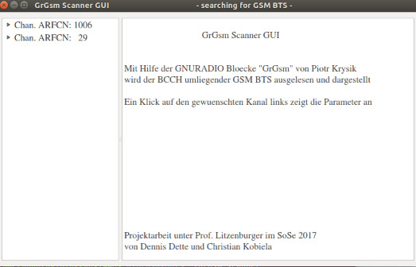
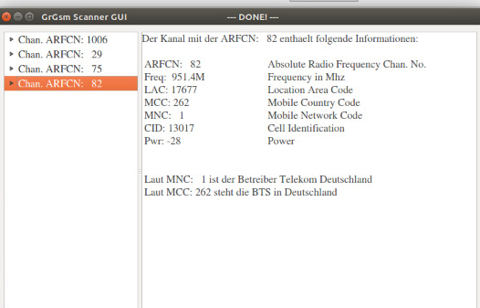
GUI

